Slide 1



Bus Pass Management

Slide 2


Presented by
Dipak Borse( 202212101961 )
Vatsal Bhunotar( 202212101960 )
Kashish Jain( 202212101987 )
Guided by,
Mr. Jatin Modi,
Assistant Professor( BCA )
Back to Agenda

Slide 3


INDEX
Project Profile | 3
Project Desciption | 4
Screen Layout | 5
Future Enhancement | 6
Conclusion | 7
Bibilography | 8
 | 9
 | 13
 | 14

Slide 4

Project Profile
Project Name | Bus Pass Management System
Project Type | Public Transport Management System
Objectives | The Bus Pass Management System aims to make bus pass services simple and easy to use. It allows users to apply and renew passes online while helping staff and admins manage the process efficiently. The system provides flexible options for users and ensures all tasks are handled smoothly. By going paperless, it supports both convenience and sustainability.

Slide 5
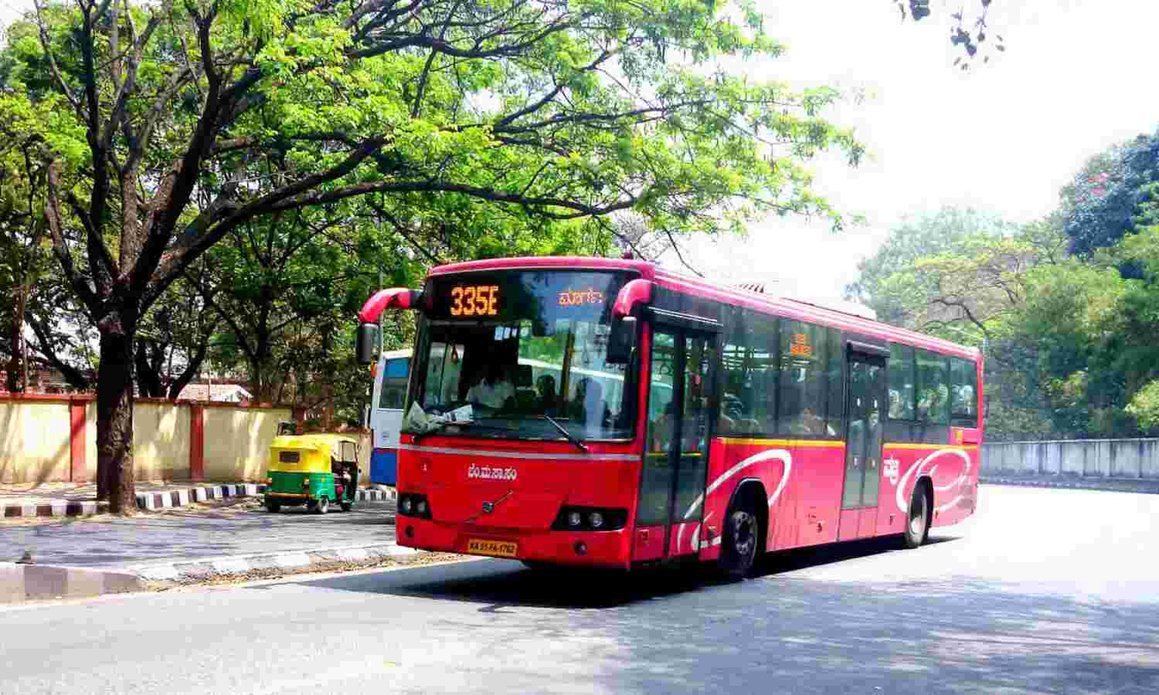
Project Desciption
The "Bus Pass Management" project is designed to issuance and renewal Bus passes for students and general passengers online.
Back to Agenda

Slide 6
Home Page
Image

Slide 7
thank
you

